Slide 1
Our Freemantle Restorative Practice
Resolving conflict in a restorative way

Slide 2
Aims – To explore a consistent approach to Restorative Practice
Everyone is welcome
Links to our Academy Vision and Values
Links to our curriculum aims – ‘Being Good Citizens’
Understanding the power of RP
Rehearsing our RP questions across a range of scenarios
Ensuring all children can access RP

Slide 3
The overall aim is to enhance a positive learning environment where pupils have the necessary skills to self regulate their behaviour and learning.
To develop an understanding of our responsibilities to the Freemantle family.
To develop emotional literacy, truth telling, accountability and responsibility.
Increasing empathy, happiness, social and communication skills
Reducing bullying, conflict and the need for sanctions.

Slide 4
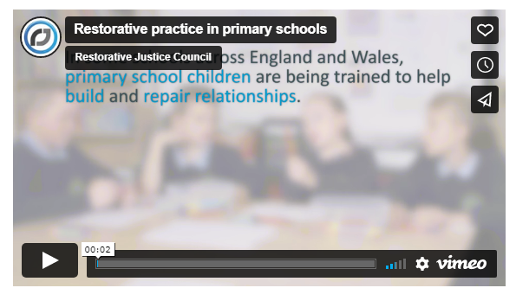
Restorative Practice – the impact
https://restorativejustice.org.uk/restorative-practice-education-0

Slide 5

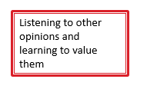

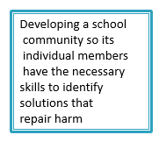
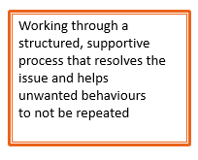
Key question: Consider any behaviour/reward chart you have used within your classroom… Are you adopting an RP approach when using this?

Slide 6
Restorative Questions
What happened?
What were you feeling at the time?
What do you feel about it now?
Who has been affected and how?
What needs to happen to put things right?
Harmed person
The harmer
Restorative Coach

Slide 7
Scenarios

Slide 8
Body language is key
Body language and tone of voice are two extremely important constituents of restorative language.
Body language needs to be non aggressive and non confrontational. This is vital to allow pupils their own personal space
Tone of voice needs to be calm, respectful and non-judgemental

Slide 9
Next step –
Try it out in your role/CPD https://restorativejustice.org.uk

